Slide 1
Section 2.5
Midpoint Formulas and Right Triangles

Slide 2
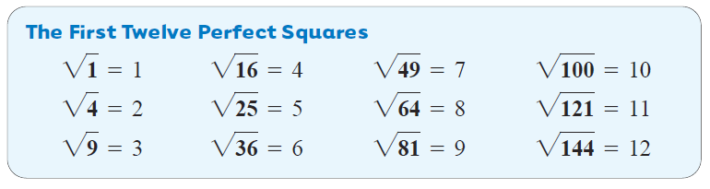
A number that has a whole number as its square root is called a perfect square.
The first few perfect squares are listed below.
Slide 8.8- 2

Slide 3
Parallel
Example 1
Find the Square Root of Numbers
Use a calculator to find each square root. Round answers to the nearest thousandth.
a.
The calculator shows 6.782329983; round to 6.782
b.
The calculator shows 11.66190379; round to 11.662
c.
The calculator shows 16.1245155; round to 16.125
Slide 8.8- 3

Slide 4
Pythagorean Theorem
(Gou Gou’s Thm)

Slide 5
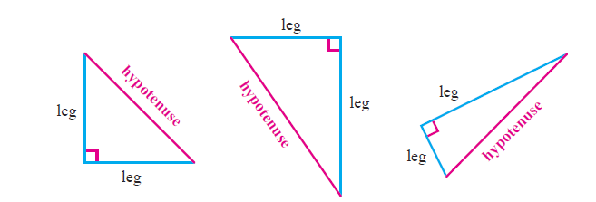
One place you will use square roots is when working with the Pythagorean Theorem. This theorem applies only to right triangles. Recall that a right triangle is a triangle that has one 90° angle. In a right triangle, the side opposite the right angle is called the hypotenuse. The other two sides are called legs.
Slide 8.8- 5

Slide 6
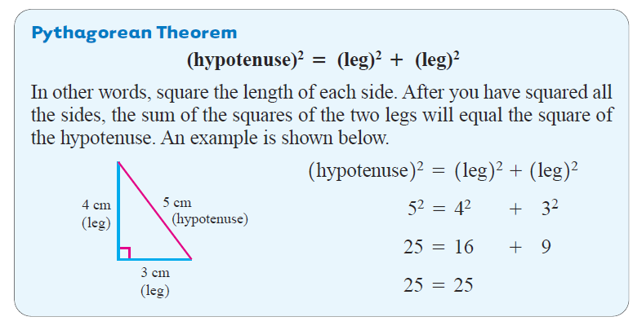

$$a^{2}+b^{2}=c^{2}$$
Where a and b are legs and
c is the hypotenuse.
Slide 8.8- 6

Slide 7
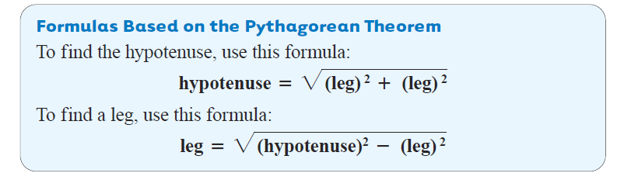
Slide 8.8- 7

Slide 8
Parallel
Example 2
Find the Unknown Length in Right Triangles
Find the unknown length in each right triangle. Round answers to the nearest tenth if necessary.
The unknown length is the side opposite the right angle. Use the formula for finding the hypotenuse.
a.
15 cm
8 cm
The length is 17 cm. long
Slide 8.8- 8

Slide 9
Parallel
Example 2
continued
Find the Unknown Length in Right Triangles
Find the unknown length in each right triangle. Round answers to the nearest tenth if necessary.
b.
Use the formula for finding the leg.
40 ft
15 ft
The length is approximately 37.1 ft long.
Slide 8.8- 9

Slide 10
Parallel
Example 3
Using the Pythagorean Theorem
An electrical pole is shown below. Find the length of the guy wire. Round your answer to the nearest tenth of a foot if necessary.
60 ft
35ft
The length of the guy wire
is approximately 69.5 ft.
Slide 8.8- 10

Slide 11
The Distance Formula

Slide 12
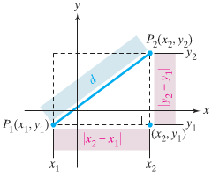
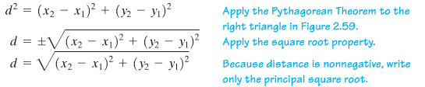

Slide 13
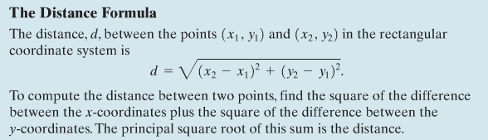

Slide 14
Example
Find the distance between (4,-5) and (9,-2).
Find the distance between (0,-2) and (-2,0)
Find the distance between (-4,-6) and (2,5)

Slide 15
Hw Section 2.5
2-11

